Slide 1
Case 2 – Prejudice? Ssy191 – Ethics presentation
By: Akos Vass, Gustav Rosin, Jonas Herzfeld & Stefan Vukman

Slide 2

The case
Laboratory interns sharing a 2-shit schedule - 08:00-16:00 and 16:00-24:00
A vote decided that Ramona would get 4 out of 5 morning shifts
Conversation between Ramona and a male colleague - Ramona remarked on feeling tired from the morning shift - Colleague didn’t think she was obliged to feel tierd since she was only working morning shifts
The same colleague remarked on the same thing with the collegues - Saying that “Ramona always get’s her way only because she a woman”
Ramona was offended at both instances, but chose to ignore in order to avoid making a scene.
Ramona chose to ignore what had happened, but during interactions with the colleague, who made a point to make Ramona fell guilty and trivial.
How should Ramona respond?

Slide 3




1. Who is the agent?
1. Ramona
2. The mean colleague
3. The rest of the interns
4. The boss / the company’s HR department

Slide 4


2. What are the alternatives?
Do nothing
Confront the mean colleague
Talk to her boss / HR department about the issue
Leave the job

Slide 5

3. Who is affected bt the alternatives and how?
If Ramona does nothing, the situation won’t change and she will be the one suffering
Confronting the colleague, Ramona will have to deal with his views and face his reaction
Talking to the boss, the boss has to make a decision on what to do. Here, Ramona, the colleague and the boss could end up in a meeting
If Ramona leaves her job, multiple possible outcomes. - The boss would want to why Ramona leaves? - The colleague would get peace - Ramona doesn’t have to put up with the colleague - The rest of the colleagues could be affected, since they loose Ramona

Slide 6



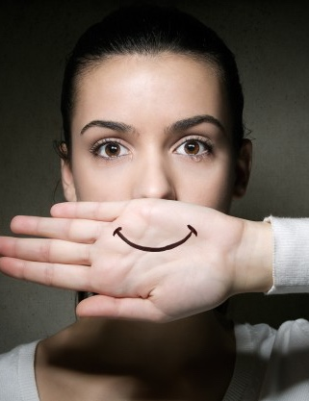
4. What are the consequences of the different alternatives?
If Ramona does nothing - the bullying might continue - Possible decrease in performance and thus her work might suffer
Confronting the colleague, multiple emotional outcomes - Colleague might realize his mistakes and apologize and stop the bullying. - He might react madly, making the bullying worse
Talking to the boss/HR - Colleague might face punishment - Ramona might not be taken seriously - If the colleague gets away, his behaviour might be acceptable and continue bullying - The colleague could be fired
Leaving the job - Not deal with colleague, but has to find a new job - The other colleagues would want to know why she is leaving, possible reaction from them - If they think she wasn’t mistreated, the bullying might continue

Slide 7


5. What are the values at stake?
Nonmaleficence: People should not feel bad while at work
Loyalty: By taking one side, the other side might feel betrayed.
Beneficence: People should feel good at work

Slide 8

6. How can different values that are in conflict be weighed together?
Maleficience VS Beneficience
Loyalty VS Maleficience
Loyalty VS Beneficience

Slide 9

7. Our recommendation
Ramona should stand up for herself and confront her colleague.
Ramona should talk to her boss and seek support. The boss has to take action to solve the issue in Ramona’s favour.
Her colleagues should show their support
Pros:
Most ethical way of approaching the situation
Protection of values non-maleficence and beneficence
Cons:
Value of loyalty has to be stressed
Disciplinary (maleficent) actions again the mean colleague might be necessary

Slide 10

Thank you for listening!

